Slide 1
Digital portfolio

Slide 2
ABOUT me
Student Name: MOHAN RAJ.H
Register no & nmid: 212400408, 720C5E18B74C48BBDBF43762DE40C58E
Department: BCA ll YEAR
College & university: Sindhi college, Madras University

Slide 3
Project title digital portfolio

Slide 4
Agenda
Project statement
Project overview
End Users
Tools & technology
Portfolio design & layout
Features & functionality
Result & screenshot
Conclusion
GitHub Link

Slide 5
Project title
In today’s digital era, traditional resumes alone are not enough to showcase skills and projects effectively. Many students and professionals lack a structured online presence to highlight their work. A digital portfolio provides an interactive and accessible platform to present achievements, skills, and experiences.

Slide 6
Project overview
Brief summary of your project. What your portfolio contains (About Me, Projects, Skills, Contact). Main idea: Showcase personal achievements, skills, and projects.

Slide 7
Edit Users
Students (academic projects, resumes).Job seekers (to share with recruiters).Freelancers (to show clients).Professionals (to highlight experience and achievements).

Slide 8
Tools & technology
Html
Structure (pages, sections).
Css
Styling (colors, layouts, responsiveness).
JavaScript
Interactivity (navigation menu, animations, form validation). Mention code editor (VS Code) or CODEPEN and hosting platform (GitHub Pages).

Slide 9
Portfolio design & layout
Sections included: Home / About Me Projects Skills Contact Responsive layout (mobile + desktop view).

Slide 10
Features & functionality
Navigation bar with smooth scrolling.
Project showcase with images/details.
Interactive elements (hover effects, animations).
Contact form (with validation).
Responsive design for all devices.

Slide 11
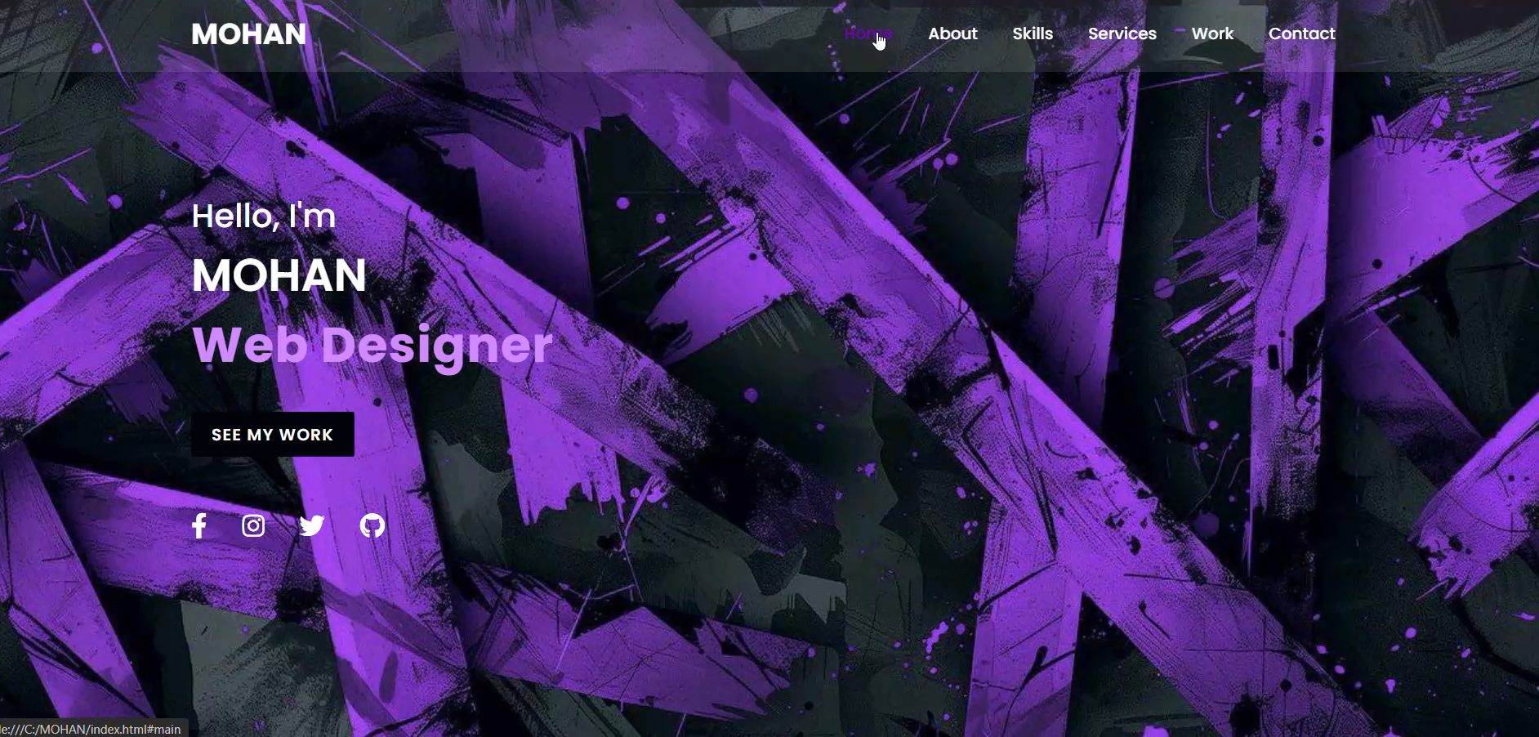
RESULTS AND SCREENSHOTS

Slide 12
Conclusion
Highlights of your project
Final summary
Benefits to society

